Slide 1
Agency Claims Management
A growing trend that is getting results….

Slide 2
Claim volumes….
Workers Compensation Claims
Handled 2014 = 3,903
3 – Sr Claims Consultants
2 - Claim Consultants / Medical Management
2 – Claim coordinators
1 – Subrogation administration

Slide 3
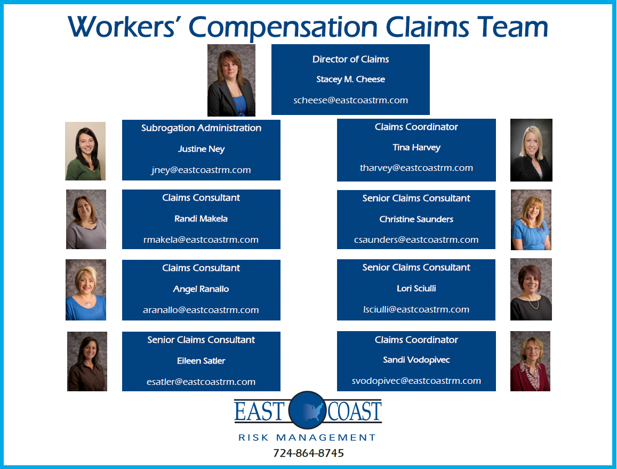
The Team…..

Slide 4
A little bragging from 2014…..
Closed claims in 2014 = 3,582 (3,903)
Kicked off 3 new KIG partners agency claims management programs in 2014.
Started a new claims management system (salesforce) which allows us to provide you with better claims trending reports.
Developed a new agency claims client webinar training process.

Slide 5
EVEN a little more bragging …..for 2015
Started Claims webinars
First one was done on 2/19/15 with 111 in attendance
The importance of timely workers compensation claims filing
Now available on the ECRM website
Next webinar will be in May 2015
HIPAA and medically managing workers compensation claims
Scheduled 2 new KIG partners agency claims management programs for this 2015 so far…

Slide 6
Bragging about the added values…..
Premium Recovery ( PCRB/Unit stats)
2013 = $50,195 checks to client (10 clients)
2014 = $ 6,248 checks to client ( 3 clients)
2015 = $ 4,037 checks to client ( 2 clients)
Recovery prior to Ex-mod impact
2015 = $ 6,730 did not impact mod or loss ratio ( 4 clients)
Currently working on 90 active recovery claims
(Subrogation, Litigation, Denied)
Linked claims = 18 (more then one employee injured in occurrence)
Timely file closures = average claim closes within 90 days.
Employee medical status is provided after each and every visit.
Loss Runs reviews are provided at valuation date and renewal, there are no suprises

Slide 7
Workers’ Compensation a policy or a program?
Premiums
Experience Mod
Loss Ratio
Old malingering claims
File Closures
Claim updates
Return to work assistance
Medical management
Loss Run Reviews
Underwriting guidelines
HR support/claims roundtables
Business decisions

Slide 8
New Trend in Underwriting….
Written Return to work Programs
Unions
FOP
Handbooks
Job descriptions
Partial benefits
Personal benefits
Job bidding
Physical abilities
Doctors release
Permanent or limited time frames

Slide 9
What is your process…..
Contact Stacey Cheese
Review agency claims contract
Schedule date for seminar
Send client notifications
Call clients prior to seminar date
Seminar conducted by Stacey Cheese
Manuals provided

Slide 10
Work Flow
Incident reported to ECRM
ECRM reports to the carrier
ECRM assigns a claims consultant
-Contact is made to employer (email/phone)
-Contact is made to the physician
-Contact is made to the employee (as needed)
ECRM sends a email with employee status (employer/carrier)
Return to work discussed
Litigation
ECRM manages for file closure
ECRM will monitor loss runs 2x per year (reserves, closures, etc)
-Valuation date
- renewal

Slide 11
Return to work
Contact on each claim
Assist in finding/creating positions
Update carrier forms/needs
Assist in documentation
Monitor reserves
Discuss restrictions
Discuss pay roll concerns
Update at each visit

Slide 12
Be the next agency in 2015 to get results…I’m Listening for our first caller….

